Slide 1
SESSION 15
Video Analytics I
Optical Flow | Background Subtraction | Motion Detection
Full Theory Session — 1 Hour

Slide 2
WHAT WE COVER TODAY
Session Roadmap
01
02
03
PART 1
PART 2
PART 3
Optical Flow
Background Subtraction
Motion Detection
Brightness constancy
Lucas-Kanade (sparse)
Farneback (dense)
Applications
Frame differencing
Gaussian models
MOG2 & KNN
Challenges
Detection pipeline
Contour extraction
Bounding boxes
Real-world use

Slide 3
PART 1
Optical Flow
Understanding how pixels move between video frames

Slide 4
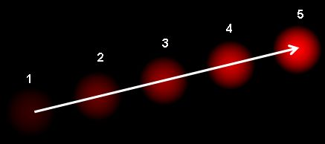
OPTICAL FLOW - FUNDAMENTALS
What is Optical Flow?
Optical flow is the pattern of apparent motion of objects, surfaces, and edges in a visual scene — caused by the relative motion between a camera and the scene.
Ball moving across 5 frames — arrows = displacement vectors
Key Idea: For every pixel, compute a 2D displacement vector (u, v) showing how it moved from frame t to frame t+1.
What it produces:
A 2D vector field over the image
Each vector = direction + speed of that point
Sparse (tracked points) or Dense (all pixels)
Source: OpenCV Documentation

Slide 5
OPTICAL FLOW - ASSUMPTIONS
The Two Core Assumptions
1
Brightness Constancy
2
Spatial Coherence
A pixel's intensity does not change between consecutive frames — even if it moves to a new location.
Neighboring pixels belong to the same surface and therefore move in a similar direction.
I(x, y, t) = I(x+dx, y+dy, t+dt)
Nearby pixels share the same velocity (u, v)
Also called the Optical Flow Constraint
Used by Lucas-Kanade to overcome the aperture problem

Slide 6
OPTICAL FLOW - MATH
The Optical Flow Equation
Applying a Taylor series expansion to the brightness constancy constraint and dividing by dt gives us the fundamental optical flow equation:
Ix * u + Iy * v + It = 0
Ix, Iy
It
u, v
Image gradients in x and y
(spatial derivatives — computed from the image)
Temporal gradient
(change in intensity between frames)
Velocity components in x and y
(UNKNOWN — what we want to find)
One equation, two unknowns (u, v) -> Under-determined -> Requires additional constraints

Slide 7
OPTICAL FLOW - APERTURE PROBLEM
The Aperture Problem
When observing motion through a small window, you can only measure the component of motion perpendicular to the edge — the true direction remains ambiguous.
THE APERTURE ANALOGY
Imagine watching a striped bar move through a small circular hole (aperture).
You can see that the bar is moving — but you cannot determine whether it is moving horizontally, vertically, or diagonally.
Only the component perpendicular to the stripe direction is visible through the aperture.
You need more context (a wider view or more pixels) to resolve the ambiguity.
1 equation vs 2 unknowns
Cannot uniquely solve for u and v with only one constraint per pixel.
How Each Method Resolves This:
Lucas-Kanade -> Uses a patch of neighboring pixels (spatial constraint)
Horn-Schunck -> Global smoothness regularization across the whole image
Deep Learning -> Learns constraints from large motion datasets (RAFT, FlowNet)

Slide 8
OPTICAL FLOW - TYPES
Sparse vs Dense Optical Flow
SPARSE
DENSE
Track a selected set of feature points (e.g. corners) from frame to frame.
Compute a motion vector for every single pixel in the frame.
Strengths:
Strengths:
Fast and efficient
Works in real time
Robust to noise
Complete motion field
Rich visualization
Better for analysis
Limitations:
Limitations:
Limited coverage
Only key points tracked
Computationally heavier
Slower to compute
cv2.calcOpticalFlowPyrLK()
cv2.calcOpticalFlowFarneback()

Slide 9
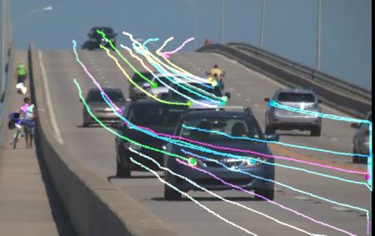
OPTICAL FLOW - SPARSE
Lucas-Kanade: Sparse Optical Flow
Lucas-Kanade solves the aperture problem by assuming all pixels in a small 3x3 patch share the same motion (u, v). This gives 9 equations for 2 unknowns — solved by least squares.
Lucas-Kanade tracking result — traffic video
1
Detect corners Use Shi-Tomasi / Harris to find good feature points to track.
2
Patch constraint For a 3x3 patch: 9 equations, 2 unknowns — over-determined system.
3
Least squares Solve for the optimal (u, v) that best fits all 9 equations.
4
Image pyramid Multi-scale pyramid handles large displacements between frames.
Colored trails show tracked point trajectories over time
Source: OpenCV Documentation

Slide 10
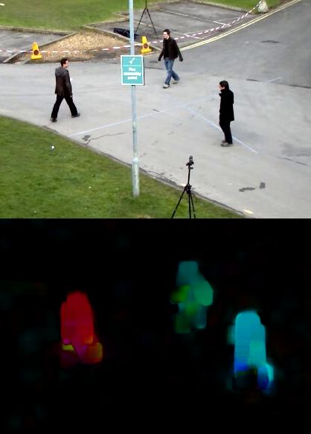
OPTICAL FLOW - DENSE
Farneback: Dense Optical Flow
Dense optical flow computes a motion vector for every pixel. Farneback's algorithm approximates each frame's neighborhood using polynomial expansion, then computes the full displacement field.
Dense flow — HSV-coded direction and speed
HSV Color Visualization
Hue (H): encodes the direction of motion Saturation: fixed at 255 Value (V): encodes the magnitude (speed) of motion
Key difference: No feature selection — the entire frame is processed.
cv2.calcOpticalFlowFarneback(
prev, next, None, 0.5, 3, 15, 3, 5, 1.2, 0)
Color = direction of movement; Brightness = speed
Source: OpenCV Documentation

Slide 11
OPTICAL FLOW
Real-World Applications
01
02
03
Video Stabilization
Autonomous Driving
Robot Navigation
Detect camera shake and compensate using the flow field
Understand scene motion to detect moving objects
Visual odometry — estimate self-motion from pixel flow patterns
04
05
06
Action Recognition
Video Compression
AR & Object Tracking
Two-stream networks use optical flow as a motion input
MPEG uses motion vectors closely related to optical flow
Track objects across frames without re-detecting every frame

Slide 12
PART 2
Background Subtraction
Separating moving foreground from the static background

Slide 13
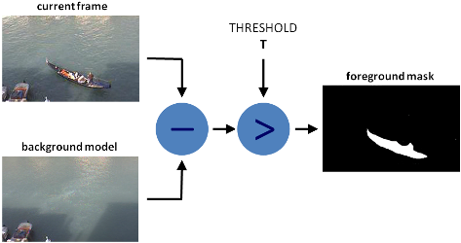
BACKGROUND SUBTRACTION - INTRO
What is Background Subtraction?
Background subtraction isolates moving objects from a scene by building a statistical model of the static background and marking pixels that deviate from it as foreground.
Background subtraction pipeline
The two-step process:
Step 1: Background Initialization Build an initial model of the static background.
Step 2: Background Update Continuously adapt the model to slow changes (lighting, shadows).
Result: A binary foreground mask — white = moving object, black = background.
Source: OpenCV Documentation

Slide 14
BACKGROUND SUBTRACTION - METHODS
Simple Frame Differencing
The simplest approach: subtract a reference background image from the current frame. Pixels where the absolute difference exceeds a threshold are classified as foreground.
Foreground(x,y,t) = |I(x,y,t) - B(x,y)| > Threshold
When It Works
Limitations
Static camera with fixed viewpoint
Good, consistent lighting
Clearly moving foreground objects
Simple, uncluttered background
Fails under lighting changes
Ghost artifacts from stationary objects
Cannot handle dynamic backgrounds
No shadow handling

Slide 15
BACKGROUND SUBTRACTION - MODELS
Statistical Background Modeling
More robust methods model each pixel as a probability distribution — allowing the background to adapt over time rather than using a fixed reference frame.
Running Average
Background is the weighted average of recent frames. Fast to compute but sensitive to sudden changes. Alpha controls learning rate.
B(t) = alpha * I(t) + (1 - alpha) * B(t-1)
Single Gaussian
Each pixel modeled with mean and variance from recent frames. Adapts to gradual changes but fails for multimodal distributions.
P(x) = N(mu, sigma^2) -> classify if |I - mu| > k * sigma
Mixture of Gaussians (MOG)
Multiple Gaussians per pixel handle multi-modal backgrounds (waving trees, reflections). Most widely used in practice.
P(x) = sum_k [ w_k * N(mu_k, sigma_k^2) ], k = 1..K

Slide 16
BACKGROUND SUBTRACTION - MOG2
MOG2: OpenCV's Background Subtractor
MOG2 (Mixture of Gaussians v2) by Zivkovic (2004) is the most commonly used background subtractor in OpenCV. It automatically selects the number of Gaussian components per pixel and includes built-in shadow detection.
1
Adaptive K
2
Shadow Detection
Automatically adjusts the number of Gaussians per pixel (1 to 5) based on background complexity.
Detects and marks shadow pixels in gray rather than white — reduces false positives significantly.
3
Online Learning
4
High Accuracy
Background model updates every frame using a configurable history length parameter.
Handles illumination changes, gradual scene shifts, and repetitive background motion.
cv2.createBackgroundSubtractorMOG2(history=500, varThreshold=16, detectShadows=True)

Slide 17
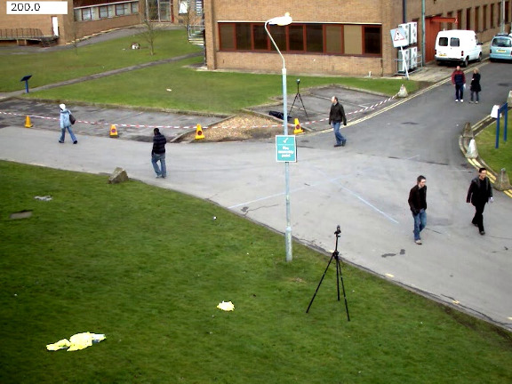
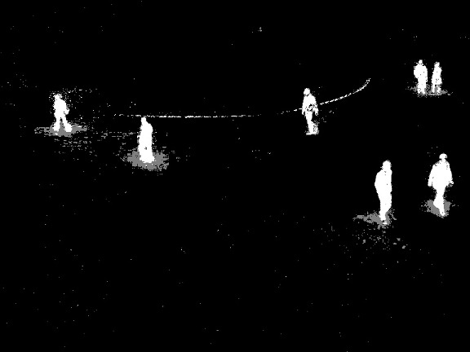
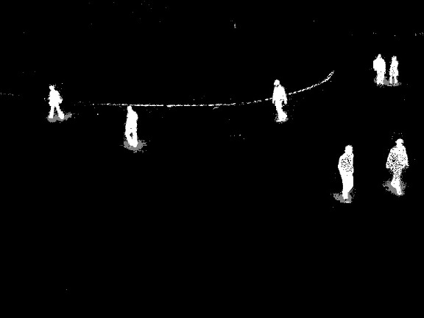
BACKGROUND SUBTRACTION - RESULTS
MOG2 vs KNN: Visual Results
Comparing background subtraction on the same traffic sequence. Gray regions = detected shadows.
Input Frame
MOG2 Result
KNN Result
Original video frame
White = foreground | Gray = shadow
K-Nearest Neighbours method
Source: OpenCV Background Subtraction Tutorial

Slide 18
BACKGROUND SUBTRACTION - CHALLENGES
Common Challenges & Limitations
Background subtraction in real-world scenes faces several difficult problems every system must address:
01
02
03
Illumination Changes
Dynamic Backgrounds
Ghost Objects
Sudden light changes (cloud cover, light switches) cause entire-frame false detections.
Waving trees, water reflections, and flickering displays are incorrectly flagged as moving objects.
When a foreground object stops moving, it gradually blends into the background model and disappears.
04
05
06
Shadows
Camouflage
Camera Motion
Cast shadows move with the object but have different intensity — often misclassified as foreground.
Objects with similar color or texture to the background become invisible to the subtractor.
Background subtraction requires a static camera. Moving cameras need stabilization first.

Slide 19
PART 3
Motion Detection
Using foreground masks to detect and locate moving objects

Slide 20
MOTION DETECTION - INTRO
What is Motion Detection?
Motion detection identifies the presence, location, and properties of moving objects in a video. It typically builds on background subtraction to go from raw pixels to meaningful events.
Level 1 — Pixel-Level Background subtraction produces a foreground mask. Answers: 'Which pixels changed?'
Level 2 — Region-Level Contour detection and bounding boxes locate objects. Answers: 'Where are the objects?'
Level 3 — Semantic-Level Object classification and tracking. Answers: 'What are they and where are they going?'
This session focuses on Levels 1 & 2 — the classical CV pipeline approach.

Slide 21
MOTION DETECTION - PIPELINE
The Classical Motion Detection Pipeline
1
Capture Frame
4
Contour Detection
Read a video frame with cv2.VideoCapture
cv2.findContours() extracts outlines of white blobs in the mask
2
Background Subtraction
5
Filter by Area
Apply MOG2/KNN to get the foreground mask (fgMask)
Discard very small contours (noise) using contourArea() threshold
3
Morphological Cleanup
6
Bounding Box
Erode then dilate to remove noise and fill holes in the mask
cv2.boundingRect() draws a rectangle around each valid contour

Slide 22
MOTION DETECTION - EXTRACTION
Contours and Bounding Boxes
After obtaining a clean foreground mask, contour analysis locates and describes each individual moving object.
Contours
Bounding Rectangles
A contour is a curve joining all continuous points along a boundary that share the same color or intensity.
The smallest axis-aligned rectangle that fully encloses a contour — gives location and size of the detected object.
contours, _ = cv2.findContours(
fgMask, cv2.RETR_EXTERNAL,
cv2.CHAIN_APPROX_SIMPLE)
x, y, w, h = cv2.boundingRect(cnt)
cv2.rectangle(frame,
(x, y), (x+w, y+h), (0,255,0), 2)
RETR_EXTERNAL returns only outermost contours — avoids nested duplicates.
Filter small boxes: if cv2.contourArea(cnt) < 500: continue

Slide 23
VIDEO ANALYTICS APPLICATIONS
Where These Techniques Are Used
01
02
03
Traffic Monitoring
Security & Surveillance
Industrial Inspection
Count vehicles, detect speeding, measure flow rates
Perimeter intrusion alerts, loitering detection
Detect defects, monitor assembly line motion
BG Sub
Motion
BG Sub
Motion
OF
Motion
04
05
06
Sports Analytics
Drone Navigation
Healthcare / Elder Care
Player tracking, ball trajectory analysis
Obstacle avoidance, visual odometry from flow
Fall detection and daily activity monitoring
OF
Motion
OF
BG Sub
Motion

Slide 24
VIDEO ANALYTICS - BIG PICTURE
How the Three Techniques Connect
These three techniques are complementary and often used together in a single video analytics pipeline.
Optical Flow
Background Sub.
Motion Detection
Dense/sparse motion
Per-pixel velocity
Works without BG model
Camera-motion aware
Static-camera focused
Binary foreground mask
Efficient processing
MOG2 / KNN algorithms
Builds on BG subtraction
Contours + bounding boxes
Event-level output
Triggers alerts / tracking

Slide 25
SESSION SUMMARY
What We Covered Today
Optical Flow
Brightness constancy constraint -> OF equation (1 eq, 2 unknowns) -> Lucas-Kanade (sparse, patch-based least squares) -> Farneback (dense, HSV visualization).
Background Subtraction
Build a background model, detect deviations as foreground. Frame diff -> Gaussian -> MOG2 (adaptive Gaussians, shadow-aware). Key challenges: lighting, dynamic backgrounds.
Motion Detection
3-level hierarchy: pixels -> regions -> semantics. Classical pipeline: BG subtraction -> morphological cleanup -> contour detection -> bounding boxes.
Next Session: Video Analytics II - Object Tracking, DeepSORT, and Action Recognition

Slide 26
SESSION 15
References & Further Reading
Optical Flow
OpenCV Docs - Optical Flow Tutorial | docs.opencv.org/4.x/d4/dee/tutorial_optical_flow.html
Lucas, B.D. & Kanade, T. (1981). An Iterative Image Registration Technique with an Application to Stereo Vision. IJCAI.
Farneback, G. (2003). Two-Frame Motion Estimation Based on Polynomial Expansion. SCIA.
Background Subtraction
OpenCV Docs - Background Subtraction Tutorial | docs.opencv.org/4.x/d1/dc5/tutorial_background_subtraction.html
Stauffer, C. & Grimson, W.E.L. (1999). Adaptive Background Mixture Models for Real-Time Tracking. CVPR.
Wikipedia - Background Subtraction | en.wikipedia.org/wiki/Background_subtraction
Motion Detection
Piccardi, M. (2004). Background Subtraction Techniques: A Review. IEEE Intl. Conference on SMC.
Wikipedia - Optical Flow | en.wikipedia.org/wiki/Optical_flow

